Slide 1

김기범
3주차 발표
Collaborative Metric Learning

Slide 2
INDEX
01 Introduction - Flow
02 Background
03 Model Explanation
04 Comparing to MF
05 Why CML
06 Discussion

Slide 3

Introduction - Flow
4.5? 4.0?
1. Focused on specific rating each user
2. Consider the Implicit feedback
3. Top K Recommendation rather than Specific rating
Drawback
4. Considering the Similar Items – learned metric
Notes:
심리학에서 나온 자극-반응의 이론을 토대로,

Slide 4
Introduction
• Implicit Feedback Drawback
1. Only Positive Feedback
Don’t Know If Negative feedback or Unknown item

Slide 5
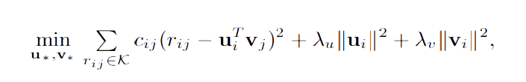
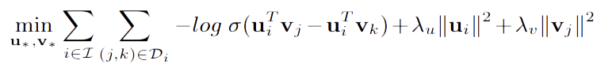
Introduction
• Weighted Regularized Matrix Factorization
• Bayesian Personalized Ranking

Slide 6





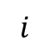
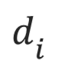
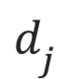
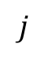
Background
• Metric Learning
- To represent the distance between Object
$$i$$
$$d_{i^{}}$$
$$d_{j^{}}$$
$$j$$

Slide 7
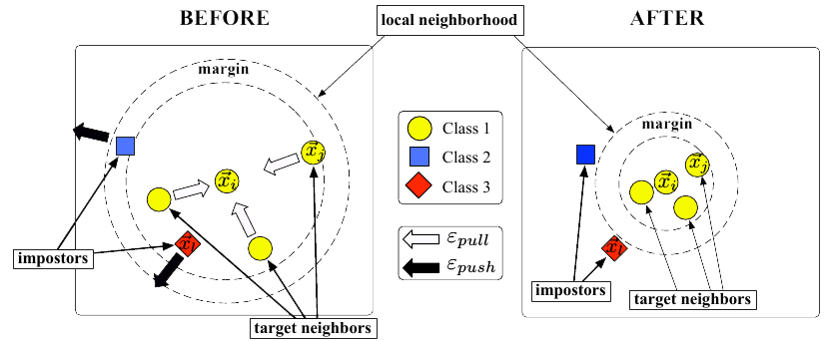
Background
• Metric Learning

Slide 8
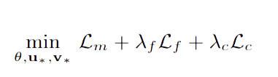
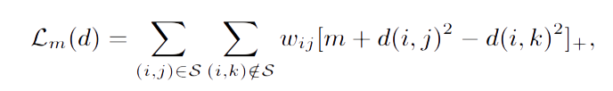




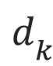
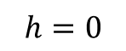
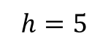
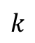
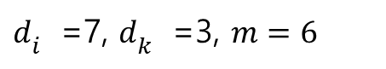
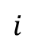
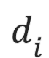
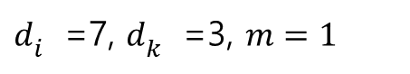
Model Explanation
1.
$d_{i^{}}$=7, $d_{k^{}}$=3, $m=1$
$$h=5$$
$$d_{i^{}}$$
$$i$$
$d_{i^{}}$=7, $d_{k^{}}$=3, $m=6$
$$h=0$$
$$d_{k^{}}$$
$$k$$

Slide 9
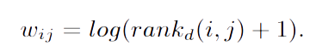
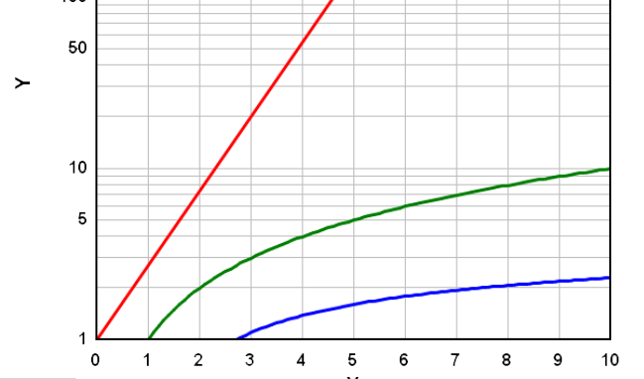
Model Explanation
http://ethen8181.github.io/machine-learning/recsys/5_warp.html

Slide 10
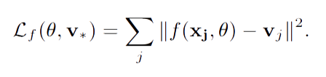
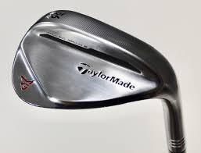
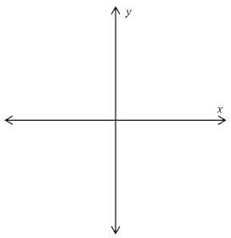
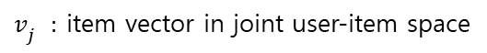
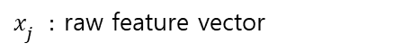
Model Explanation
$x_{j^{}}:$ raw feature vector
$f(x,θ)$: transformation function
$v_{j^{}}:$ item vector in joint user-item space
f(x)

Slide 11
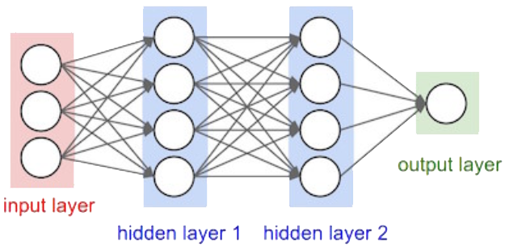
Model Explanation
Input : Raw Feature vector
Output : Latent Vector in joint user-item Space

Slide 12
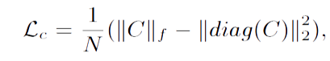
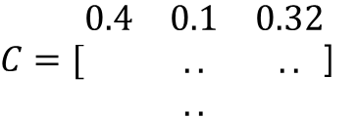
Model Explanation
1 2 3
1
$C=[\begin{matrix}0.4 & 0.1 & 0.32 \\ & .. & .. \\ & .. & \end{matrix}$]
For reducing the correlation between each dimension

Slide 13
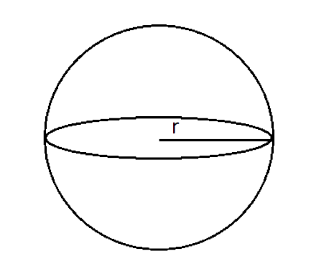
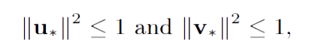
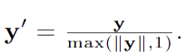
Model Explanation
r=1
v
For robustness of learned Metric

Slide 14
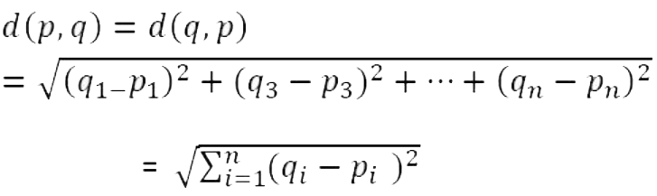
Comparing to MF
In terms of Distance
Matrix Factorization : $v_{i^{}}•u_{j^{}}$
CML :

Slide 15
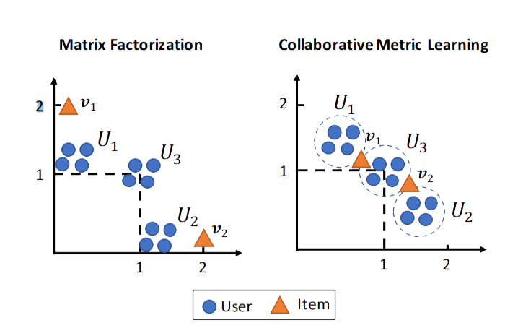
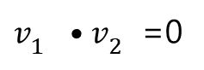
Comparing to MF
In terms of Distance
Triangle Inequality Violated!!
$v_{1^{}}•v_{2^{}}$=0

Slide 16
Why CML?
Why CML?
1. Capture User’s Preference Well
2. Capture Unobserved item relevant to preferred item
3. Observe the image preference spectrum by visualization

Slide 17
Discussion
Discussion
1. How to model the CML to input user-feature
1-2. With 1 subject, Compare CML to content-based approach
2. Determine the layer of MLP in consideration of time
3. Integrate explicit feedback with CML

